Slide 1

Elementary Programming
TUIT
C++ Programming, Fall 2016
Lab #2
(I - part)

Slide 2
Read the lecture notes doing following tasks:
TUIT
Practice (I - part)
Convert Celsius to Fahrenheit;
Compute the volume of a cylinder;
Convert feet into meters;
Convert pounds into kilograms;
*Financial application: calculate tips;
**Sum the digits in an integer;
*Find the number of years;
*Current time;
Physics: acceleration;
Science: calculating energy;
*Health application: BMI;
*Science: wind-chill temperature;

Slide 3


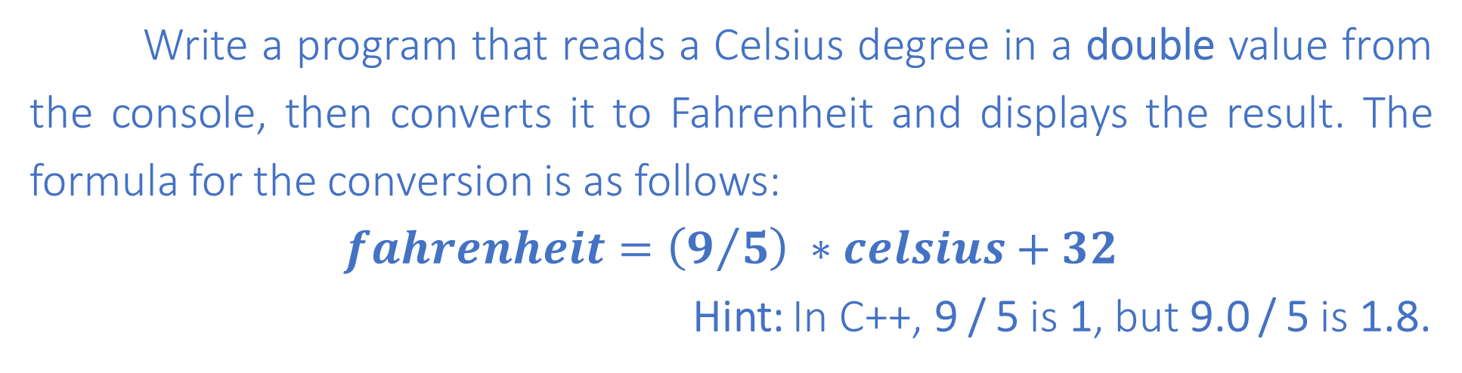
TUIT
1. Convert Celsius to Fahrenheit
Write a program that reads a Celsius degree in a double value from the console, then converts it to Fahrenheit and displays the result. The formula for the conversion is as follows:
$$fahrenheit=\left(9/5\right) ∗celsius+32$$
Hint: In C++, 9 / 5 is 1, but 9.0 / 5 is 1.8.
Here is a sample run:
Enter a degree in Celsius: 43 43 Celsius is 109.4 Fahrenheit

Slide 4
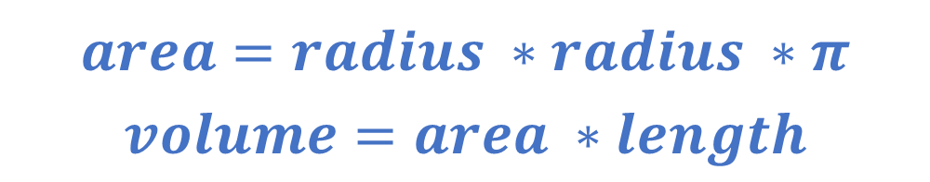
TUIT
2. Compute the volume of a cylinder
Write a program that reads in the radius and length of a cylinder and computes the area and volume using the following formulas:
area
$$area=radius ∗radius ∗π$$
$$volume=area ∗length$$
length
radius
Here is a sample run:
Enter the radius and length of a cylinder: 5.5 12 The area is 95.0331 The volume is 1140.4

Slide 5
TUIT
3. Convert feet into meters
Write a program that reads a number in feet, converts it to meters, and displays the result. One foot is 0.305 meter.
Here is a sample run:
Enter a value for feet: 16.5 16.5 feet is 5.0325 meters

Slide 6
TUIT
4. Convert pounds into kilograms
Write a program that converts pounds into kilograms. The program prompts the user to enter a number in pounds, converts it to kilograms, and displays the result. One pound is 0.454 kilograms.
Here is a sample run:
Enter a number in pounds: 55.5 55.5 pounds is 25.197 kilograms

Slide 7
TUIT
5. *Financial application: calculate tips
Write a program that reads the subtotal and the gratuity rate, then computes the gratuity and total. For example, if the user enters 10 for subtotal and 15% for gratuity rate, the program displays $1.5 as gratuity and $11.5 as total.
Here is a sample run:
Enter the subtotal and a gratuity rate: 10 15 The gratuity is $1.5 and total is $11.5

Slide 8
TUIT
6. **Sum the digits in an integer
Write a program that reads an integer between 0 and 1000 and adds all the digits in the integer. For example, if an integer is 392, the sum of all its digits is 14.
Hint: Use the % operator to extract digits, and use the / operator to remove the extracted digit. For instance, 932 % 10 = 2 and 932 / 10 = 93.
Here is a sample run:
Enter a number between 0 and 1000: 999 The sum of the digits is 27

Slide 9
TUIT
7. *Find the number of years
Write a program that prompts the user to enter the minutes (e.g. 1 billion), and displays the number of years and days for the minutes. For simplicity, assume a year has 365 days.
Here is a sample run:
Enter a number of minutes: 1000000000 1000000000 minutes is approximately 1902 years and 214 days

Slide 10
TUIT
8. *Current time
ShowCurrentTime.cpp, gives a program that displays the current time in GMT. Revise the program so that it prompts the user to enter the time offset to GMT and displays the time in the specified time zone.
Here is a sample run:
Enter the time zone offset to GMT: -5 The current time is 4:50:34

Slide 11

TUIT
9. Physics: Acceleration
Average acceleration is defined as the change of velocity divided by the time taken to make the change, as shown in the following formula:
$$a= \frac{v_{1}−v_{0}}{t}$$
Write a program that prompts the user to enter the starting velocity $v_{0}$ in meters/second, the ending velocity $v_{1}$ in meters/second, and the time span t in seconds, and displays the average acceleration.
Here is a sample run:
Enter v0, v1, and t: 5.5 50.9 4.5 The average acceleration is 10.0889

Slide 12
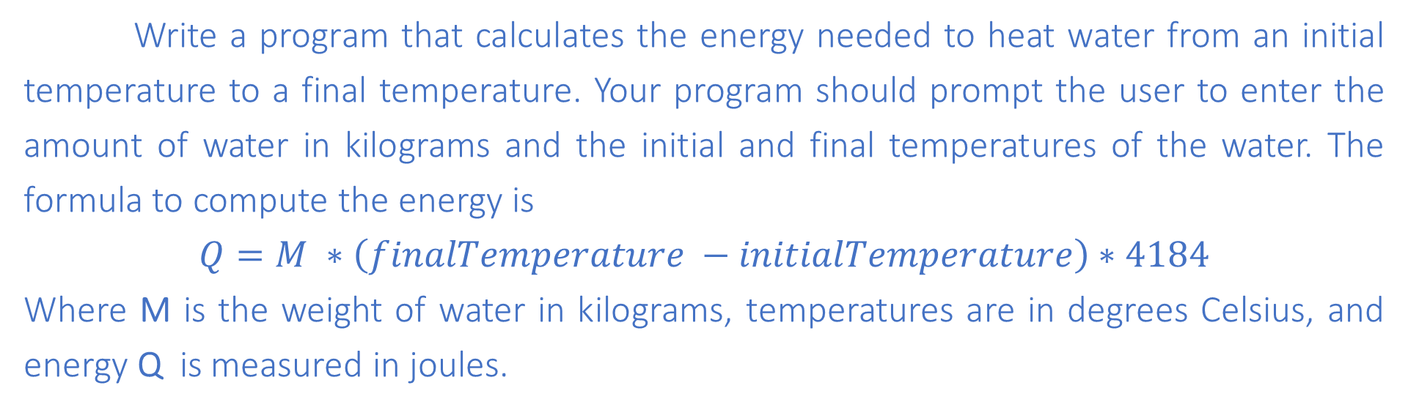
TUIT
10. Science: calculating energy
Write a program that calculates the energy needed to heat water from an initial temperature to a final temperature. Your program should prompt the user to enter the amount of water in kilograms and the initial and final temperatures of the water. The formula to compute the energy is
$$Q=M ∗\left(finalTemperature −initialTemperature\right)∗4184$$
Where M is the weight of water in kilograms, temperatures are in degrees Celsius, and energy Q is measured in joules.
Here is a sample run:
Enter the amount of water in kilograms: 55.5 Enter the initial temperature: 3.5 Enter the final temperature: 10.5 The energy needed is 1625484.0

Slide 13
TUIT
11. *Health application: BMI
Body Mass Index (BMI) is a measure of health on weight. It can be calculated by taking your weight in kilograms and dividing by the square of your height in meters. Write a program that prompts the user to enter a weight in pounds and height in inches and displays the BMI. Note that one pound is 0.45359237 kilograms and one inch is 0.0254 meters.
Here is a sample run:
Enter weight in pounds: 95.5 Enter height in inches: 50 BMI is 26.8573

Slide 14
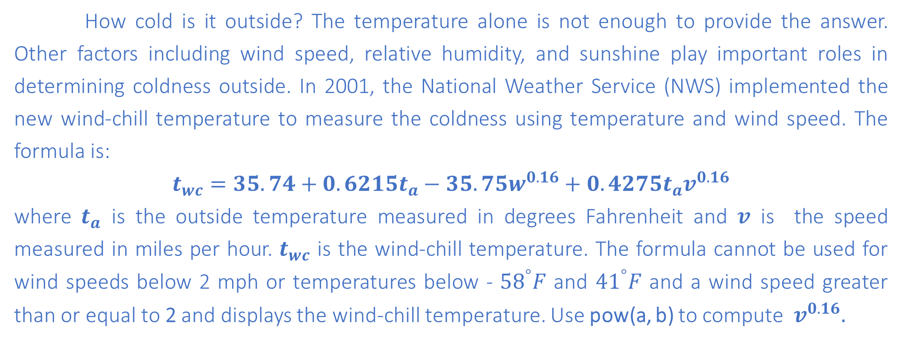
TUIT
12. *Science: Wind-chill tepmerature
How cold is it outside? The temperature alone is not enough to provide the answer. Other factors including wind speed, relative humidity, and sunshine play important roles in determining coldness outside. In 2001, the National Weather Service (NWS) implemented the new wind-chill temperature to measure the coldness using temperature and wind speed. The formula is:
$$t_{wc}=35.74+0.6215t_{a}−35.75w^{0.16}+0.4275t_{a}v^{0.16}$$
where $t_{a}$ is the outside temperature measured in degrees Fahrenheit and $v$ is the speed measured in miles per hour. $t_{wc}$ is the wind-chill temperature. The formula cannot be used for wind speeds below 2 mph or temperatures below - ${58}^{°}F$ and ${41}^{°}F$ and a wind speed greater than or equal to 2 and displays the wind-chill temperature. Use pow(a, b) to compute $v^{0.16}.$
Here is a sample run:
Enter the temperature in Fahrenheit: 5.3 Enter the wind speed in miles per hour: 6 The wind chill index is -5.56707

